Slide 1
Those who wish to succeed must ask the right preliminary questions
Aristotle
◆ Mechanics of the human visual system
◆ The light and its imaging characteristics
◆ Digital image generating
◆ Sampling and quantization issues
◆ Some basic relationship between pixels
◆ Conditions for linear operations

Slide 2
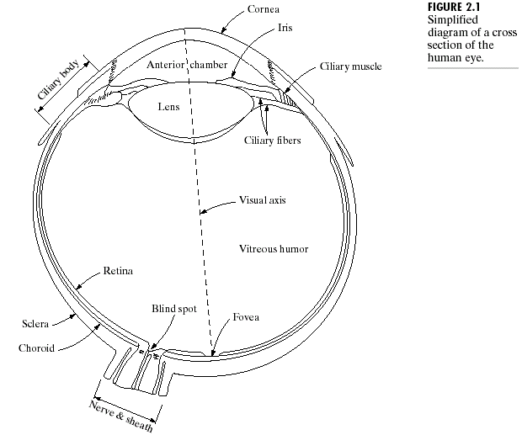
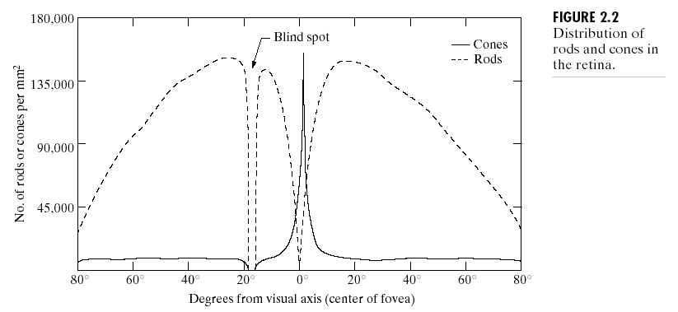
2.1 Elements of Visual Perception
The Eye
角膜
虹膜
睫状体
前房
Cone vision:
photopic or bright- light vision
睫状肌
晶状体
睫状小带
Rods vision:
scotopic or dim- light vision
视轴
视网膜
玻璃体
盲点
巩膜
中央凹
1.5 x 1.5 mm, 337,000 elements
Like a medium resolution CCD of 5 x 5 mm
脉络膜

Slide 3
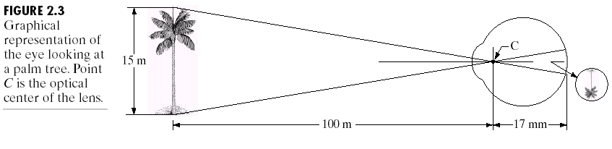
Image Formation in the Eye
A camera? Somewhat

Slide 4
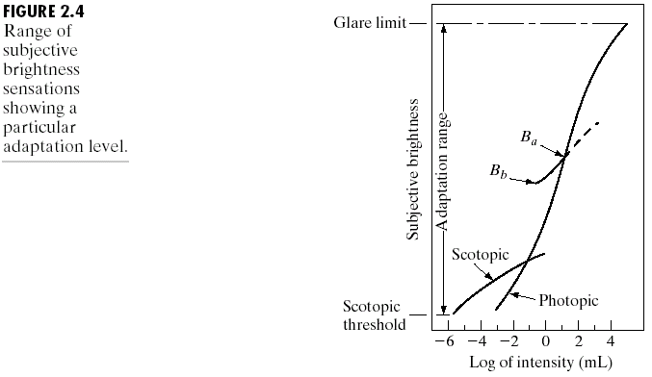
Brightness Adaptation and Discrimination
The range of light intensity levels to which the human visual system can adapt is enormous - on the order of 10¹⁰- from the scotopic threshold to the glare limit.
Experimental evidence indicates that subjective brightness (intensity as perceived by the human visual system) is a logarithmic function of the light intensity incident on the eye. (Weber-Fechner law )

Slide 5
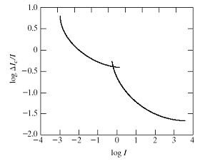
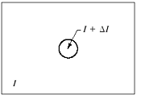


Brightness Adaptation and Discrimination
On the other hand, the visual system cannot operate over such a range simultaneously. Rather, it accomplishes this large variation by changes in its overall sensitivity, a phenomenon known as brightness adaptation.
The ability of the eye to discriminate between changes in light intensity at any specific adaptation level is also of considerable interest.

Slide 6
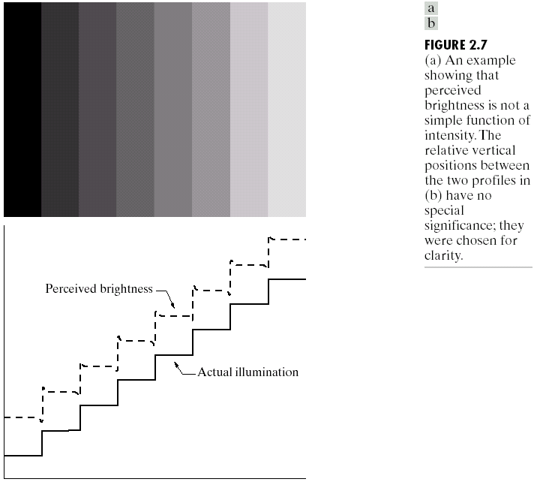
Objective vs Subjective
The perceived brightness is not a simple function of intensity.
Mach Bands
Overshoot/scallop

Slide 7
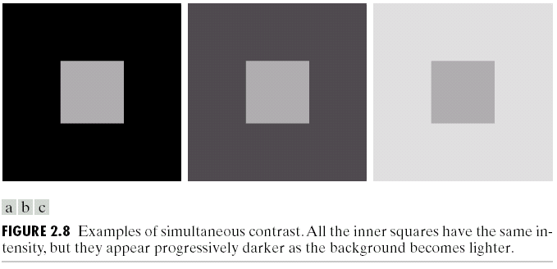
Objective vs Subjective
A region’s perceived brightness does not depend simply on its intensity, a phenomenon called simultaneous contrast.

Slide 8
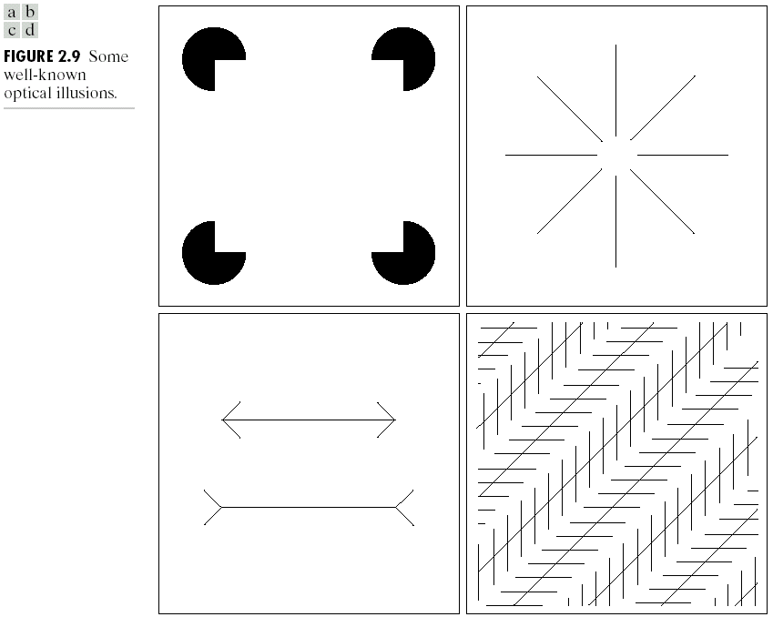
What’s Wrong with our Eyes?
Human perception phenomena also include optical illusions, in which the eye fills in nonexisting information or wrongly perceives geometrical
properties of objects.
Not fully understand so far

Slide 9
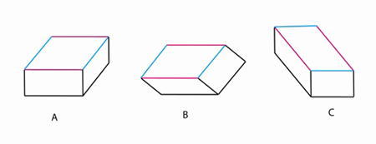
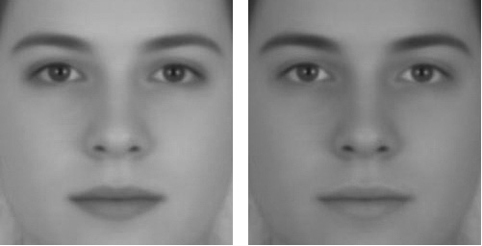
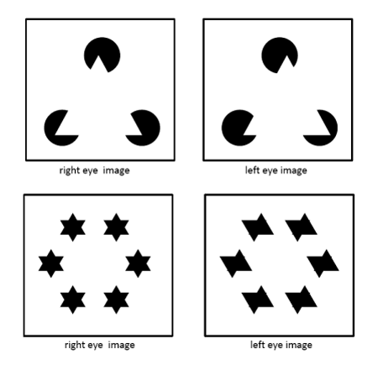

What’s Wrong with our Eyes?

Slide 10
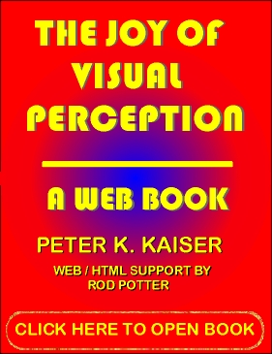
A web Book

Slide 11
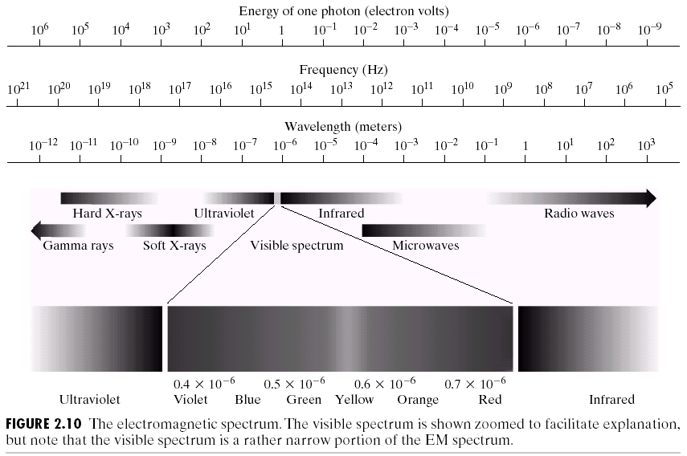


2.2 Light and EM Spectrum

Slide 12
Chromatic and Monochromatic
The colors that humans perceive in an object are determined by the nature of the light reflected from the object.
Three basic quantities are used to describe the quality of a chromatic light source: radiance; luminance; and brightness.
Radiance is the total amount of energy that flows from the light source, and it is usually measured in watts (W).
Luminance, measured in lumens (lm), gives a measure of the amount of energy an observer
perceives from a light source.
Brightness is a subjective descriptor of light perception that is practically impossible to measure.
The only attribute of achromatic light is its intensity, or amount.
Brightness is the achromatic notion of intensity and is one of the key factors in describing color sensation.

Slide 13
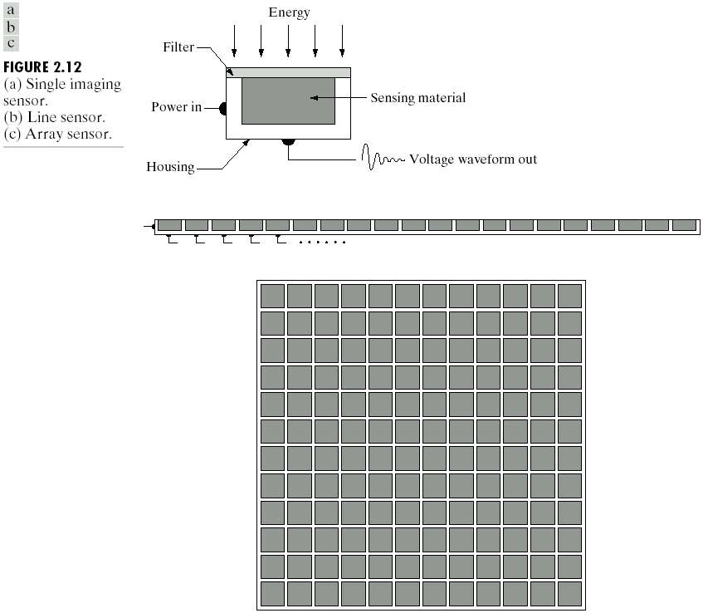
2.3 Image Sensing and Acquisition
There are three principal sensor arrangements used to transform illumination energy into digital images.
The idea is simple: Incoming energy is transformed into a voltage by the combination of input electrical power and sensor material that is responsive to the particular type of energy being detected.
The output voltage waveform is the response of the sensor(s), and a digital quantity is obtained from each sensor by digitizing its response.

Slide 14
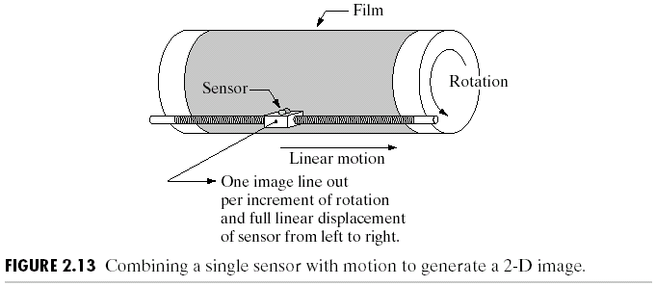
2.3.1 Image Acquisition Using a Single Sensor
The most familiar single sensor is the photodiode, which is constructed of silicon materials and whose output voltage waveform is proportional to light.
In order to generate a 2-D image using a single sensor, there has to be relative
displacements in both the x- and y-directions between the sensor and the area to be imaged. In other words, a scan mechanism.

Slide 15
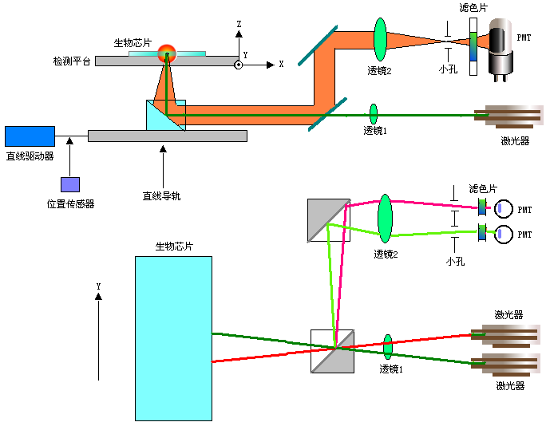
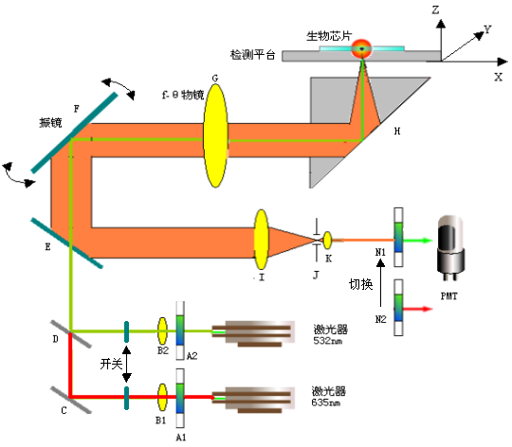
An Example: Microarray Laser Scanner

Slide 16
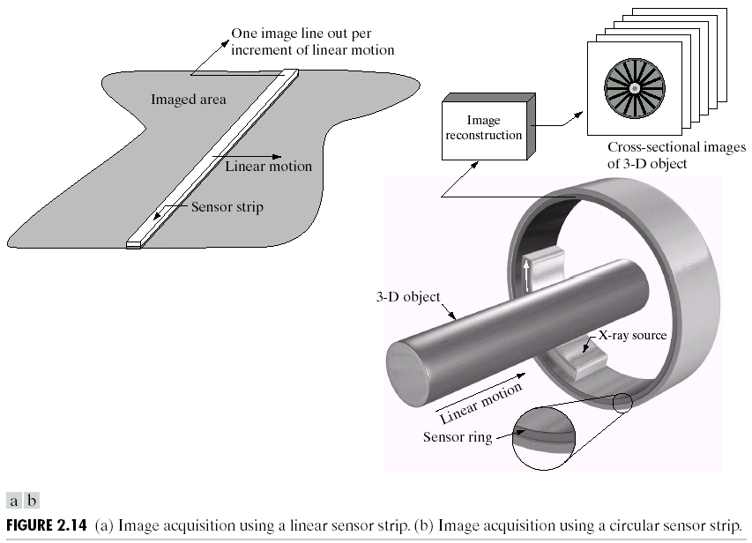
2.3.2 Image Acquisition Using Sensor Strips

Slide 17

2.3.3 Image Acquisition Using Sensor Arrays

Slide 18




2.3.4 A Simple Image Formation Model
When an image is generated from a physical process, its values are proportional to energy radiated by a physical source (e.g., electromagnetic waves). As a consequence, f(x,y) must be nonzero and finite; that is,
(2.3-1)
The function f(x, y) may be characterized by two components: (1) the amount of source illumination incident on the scene being viewed, and (2) the amount of illumination reflected by the objects in the scene.Appropriately, these are called the illumination and reflectance components and are denoted by i(x, y) and r(x, y), respectively.The two functions combine as a product to form f(x, y):
i(x, y): (lm/m²)
clear day 90,000
cloudy day 10,000
clear evening 0.1
office 1000
r(x, y):
black velvet 0.01
stainless steel 0.65
flat-white wall 0.80
silver-plated metal 0.90
snow 0.93
(2.3-2)
where
(2.3-3)
and
(2.3-4)

Slide 19
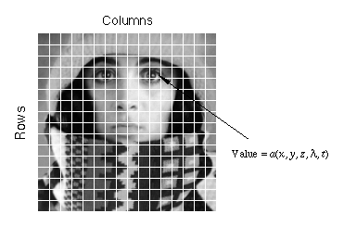
2.4 Image Sampling and Quantization
The output of most sensors is a continuous voltage waveform whose amplitude and spatial behavior are related to the physical phenomenon being sensed. To create a digital image, we need to convert the continuous sensed data into digital form.This involves two processes: sampling and quantization.
To convert an image to digital form, we have to sample the function in both coordinates and in amplitude. Digitizing the coordinate values is called sampling. Digitizing the amplitude values is called quantization.

Slide 20


2.4.1 Basic Concepts in Sampling and Quantization
The quality of a digital image is determined to a large degree by the number of samples and discrete gray levels used in sampling and quantization. However, as shown below, image content is an important consideration in choosing these parameters.

Slide 21
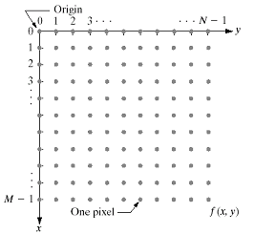
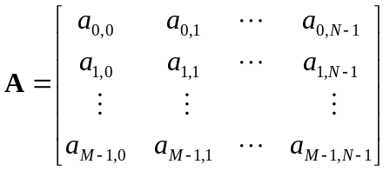
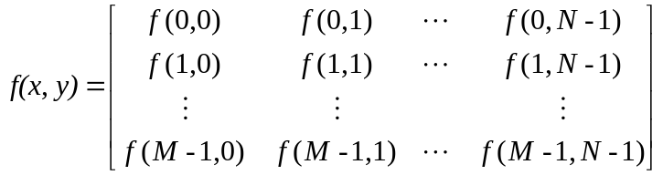
2.4.2 Representing Digital Images
FIGURE 2.18
Coordinate convention used in this class to represent digital images
M rows
N columns
(2.4-2)
(2.4-1)
The right side of this equation is by definition a digital image. Each element of this matrix array is called an image element, picture element, pixel, or pel. The terms image and pixel will be used throughout the rest of our discussions to denote a digital image and its elements.

Slide 22
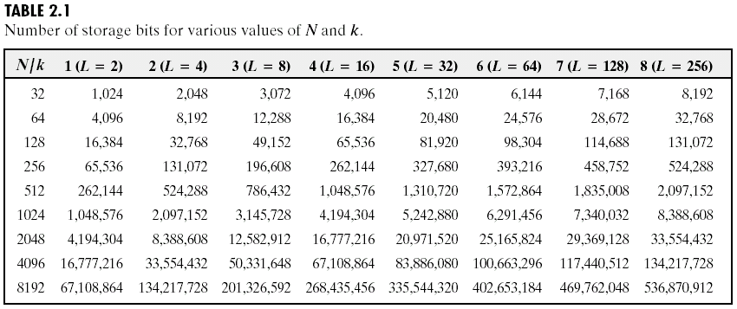



Some Conventions
The digitization process requires decisions about values for M, N , and for the number, L, of discrete gray levels allowed for each pixel. There are no requirements on M and N, other than that they have to be positive integers. However, due to processing, storage, and sampling hardware considerations, the number of gray levels typically is an integer power of 2:
(2.4-3)
When k = 1, it is a binary image, and a gray-scale image when k > 1.
We assume that the discrete levels are equally spaced and that they are integers in the interval [0,L-1]. Sometimes the range of values spanned by the gray scale is called the dynamic range of an image, and we refer to images whose gray levels span a significant portion of the gray scale as having a high dynamic range. When an appreciable number of pixels exhibit this property, the image will have high contrast. Conversely, an image with low dynamic range tends to have a dull, washed out gray look.
The number, b, of bits required to store a digitized image is
(2.4-4)
When M = N, this equation becomes
(2.4-5)

Slide 23
2.4.3 Spatial and Gray-Level Resolution
Sampling is the principal factor determining the spatial resolution of an image. Basically, spatial resolution is the smallest discernible detail in an image.
Gray-level resolution similarly refers to the smallest discernible change in gray level, but as before, measuring discernible changes in gray level is a highly subjective process.
Due to hardware considerations, the number of gray levels is usually an integer power of 2. The most common number is 8 bits, with 16 bits being used in some applications where enhancement of specific gray-level ranges is necessary.
It is common to refer to an L-level digital image of size M × N as having a spatial resolution of M × N pixels and a gray-level resolution of L levels.

Slide 24
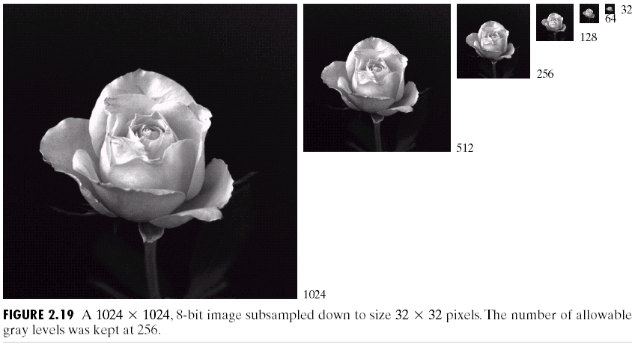
Typical Effects of Varying the Number of Samples in a Digital Image
The subsampling was accomplished by deleting the appropriate number of rows and columns from the original image.
The size differences make it difficult to see the effects resulting from a reduction in the number of samples.

Slide 25
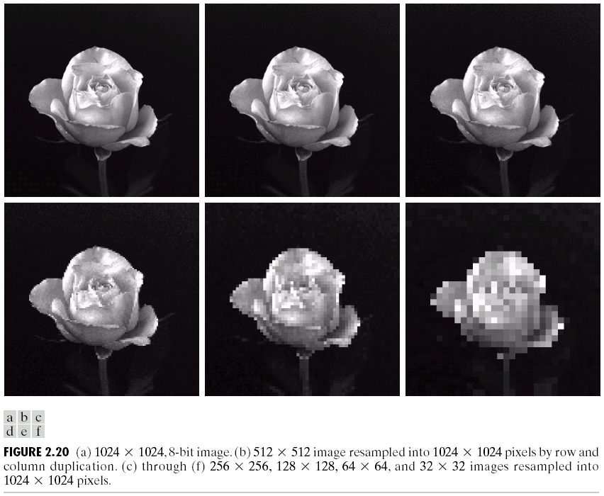
Typical Effects of Varying the Number of Samples in a Digital Image
The simplest way to compare these effects is to bring all the subsampled images up to size 1024*1024 by row and column pixel replication.
Checkerboard pattern and graininess become more and more pronounced.

Slide 26

Typical Effects of Varying the Number of Gray Levels in a Digital Image
CT projection image. Images such as this are obtained by fixing the X-ray source in one position, thus producing a 2-D image in any desired direction. Projection images are used as guides to set up the parameters for a CT scanner, including tilt, number of slices, and range.
The 256-, 128-, and 64-level images are visually identical for all practical purposes. The 32-level image, however, has an almost imperceptible set of very fine ridgelike structures in areas of smooth gray levels (particularly in the skull).

Slide 27

Typical Effects of Varying the Number of Gray Levels in a Digital Image
The ridgelike effect, caused by the use of an insufficient number of gray levels in smooth areas of a digital image, is called false contouring, so called because the ridges resemble topographic contours in a map. False contouring generally is quite visible in images displayed using 16 or less uniformly spaced gray levels,
As a very rough rule of thumb, and assuming powers of 2 for convenience,
images of size 256*256 pixels and 64 gray levels are about the smallest images that can be expected to be reasonably free of objectionable sampling checkerboards and false contouring.

Slide 28
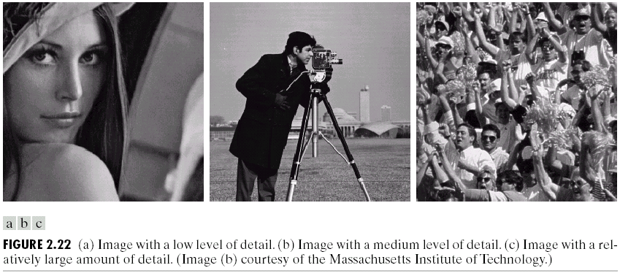
Relationship Between Spatial and Gray Levels Resolution
The above results only partially answer the question of how varying N and k affect images. One has to consider relationships that might exist between these two parameters.
An early study by Huang [1965] attempted to quantify experimentally the effects on image quality produced by varying N and k simultaneously.

Slide 29
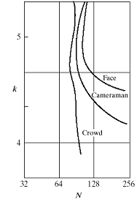
Isopreference Curves
FIGURE 2.18
Representative
isopreference
curves for the
three types of
images in
Fig. 2.22.
Sets of these three types of images were generated by varying N and k, and observers were then asked to rank them according to their subjective quality. Results were summarized in the form of so-called isopreference curves in the
Nk-plane
The key point of interest is that isopreference curves tend to become more vertical as the detail in the image in-creases. This result suggests that for images with a large amount of detail only a few gray levels may be needed.
It is also of interest to note that perceived quality in the other two image categories remained the same in some intervals in which the spatial resolution was increased, but the number of gray levels actually decreased. The most likely reason for this result is that a decrease in k tends to increase the apparent contrast of an image, a visual effect that humans often perceive as improved quality in an image.

Slide 30
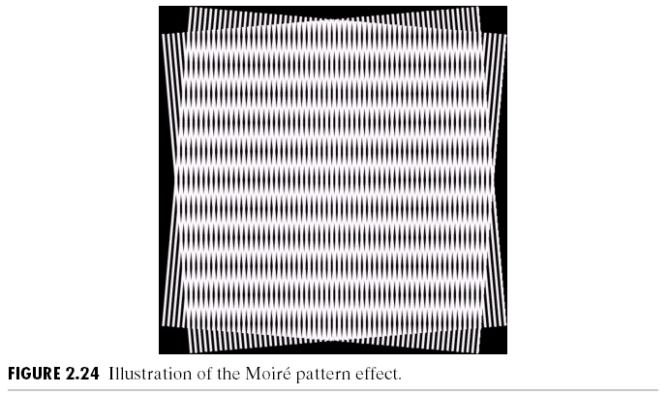
2.4.4 Aliasing and Moiré Patterns
Except for a special case, it is impossible to satisfy the sampling theorem in practice. We can only work with sampled data that are finite in duration. We can model the process of converting a function of unlimited duration into a function of finite duration simply by multiplying the unlimited function by a “gating function” that is valued 1 for some interval and 0 elsewhere.
Unfortunately, this function itself has frequency components that extend to infinity. Thus, the very act of limiting the duration of a band-limited function causes it to cease being band limited, which causes it to violate the key condition of the sampling theorem.

Slide 31
2.4.5 Zooming and Shrinking Digital Images
This topic is related to image sampling and quantization because zooming may be viewed as oversampling, while shrinking may be viewed as undersampling.
Zooming requires two steps: the creation of new pixel locations, and the assignment of gray levels to those new locations.
Conceptually, one of the easiest ways to visualize zooming is laying an imaginary lager grid over the original image.
In order to perform gray-level assignment for any point in the overlay, we look for the closest pixel in the original image and assign its gray level to the new pixel in the grid. When we are done with all points in the overlay grid, we simply expand it to the original specified size to obtain the zoomed image.
Pixel filling or
Backward-mapping
This method of gray-level assignment is called nearest neighbor interpolation.
Pixel replication is a special case of nearest neighbor interpolation and is applicable when we want to increase the size of an image an integer number of times.
Image shrinking is done in a similar manner as for zooming. The equivalent process of pixel replication is row-column deletion. We can use the zooming grid analogy to visualize the concept of shrinking by a noninteger factor, except that we now expand the grid to fit over the original image, do gray-level nearest neighbor interpolation, and then shrink the grid back to its original specified size.

Slide 32

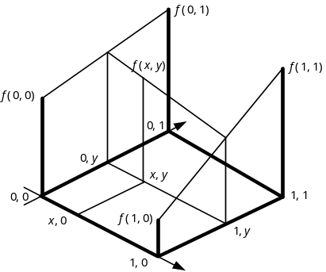
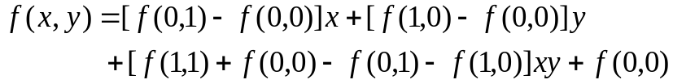
The Interpolation
Although nearest neighbor interpolation is fast, it has the undesirable feature that it produces a checkerboard effect that is particularly objectionable at high factors of magnification.
A slightly more sophisticated way of accomplishing gray-level assignments is first-order, or bilinear, interpolation using the four nearest neighbors of a point.
Let f(x,y) be a function of two variables that is known at the vertices of the unit square. Suppose we desire to establish by interpolation the value of f(x,y) at an arbitrary point inside the square. We can do so by fitting a hyperbolic paraboloid, defined by the bilinear equation
(2.4-6)
through the four known values.
There is a simple algorithm that produces a bilinear interpolation function which fits f(x,y) at the corners
Using higher order interpolation and/or more neighbors implies fitting the points with a more complex surface, which generally gives smoother results. This is an exceptional important consideration in image generation for 3-D graphics [Watt (1993)] and in medical image processing [Lehmann et al. (1999)].

Slide 33
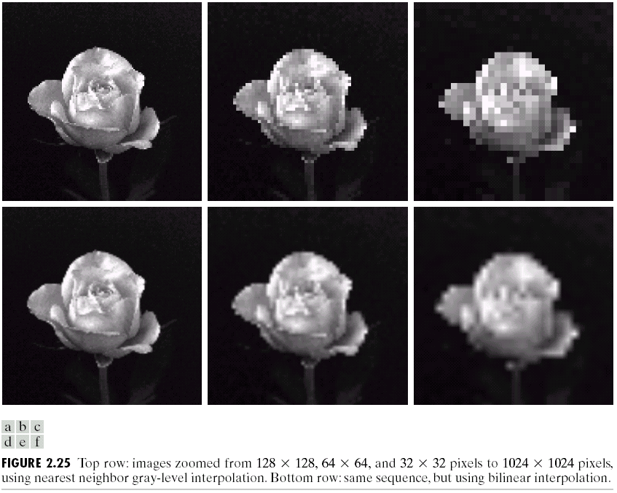
A Zooming Example with Two Interpolation Methods

Slide 34
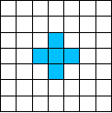
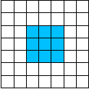

2.5 Some Basic Relationships Between Pixels
A pixel p at coordinates (x,y) has four horizontal and vertical neighbors whose coordinates are given by
This set of pixels, called the 4-neighbors of p, is denoted by N₄(p). Each pixel is a unit distance from (x,y), and some of the neighbors of p lie outside the digital image if (x,y) is on the border of the image.
The four diagonal neighbors of p have coordinates
and are denoted by N_{D}(p). These points, together with the 4-neighbors, are called the 8-neighbors of p, denoted by N₈(p). As before, some of the points in N_{D}(p) and N₈(p) fall outside the image if (x,y) is on the border of the image.

Slide 35
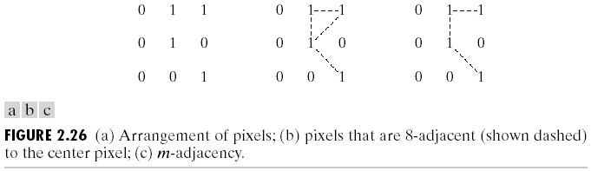
2.5.2 Adjacency, Connectivity, Regions and Boundaries
Connectivity between pixels is a fundamental concept that simplifies the definition of numerous digital image concepts, such as regions and boundaries. To establish if two pixels are connected, it must be determined if they are neighbors and if their gray levels satisfy a specified criterion of similarity (say, if their gray levels are equal).
Let V be the set of gray-level values used to define adjacency. We consider three types of adjacency:
(a) 4-adjacency. Two pixels p and q with values from V are 4-adjacent if q is in the set N₄(p).
(b) 8-adjacency. Two pixels p and q with values from V are 8-adjacent if q is in the set N₈(p).
(c) m-adjacency (mixed adjacency). Two pixels p and q with values from V are m-adjacent if
(i) q is in N₄(p), or
(ii) q is in N_{D}(p) and the set N₄(p)∩N₄(q) has no pixels whose values are from V.
Mixed adjacency is a modification of 8-adjacency. It is introduced to eliminate the ambiguities that often arise when 8-adjacency is used.
Adjacent means 4-, 8-, or m-adjacent.

Slide 36
Adjacency, Connectivity, Regions and Boundaries
Two image subsets S₁ and S₂ are adjacent if some pixel in S₁ is adjacent to some pixel in S₂.
A (digital) path (or curve) from pixel p with coordinates (x,y) to pixel q with coordinates (s,t) is a sequence of distinct pixels with coordinates
(x₀,y₀), (x₁,y₁), … (x_{n},y_{n})
where (x₀,y₀) = (x,y), (x_{n},y_{n}) = (s,t), and pixels (x_{i-1},y_{i-1}) and (x_{i},y_{i}) are adjacent for 1≤ i ≤ n. In this case, n is the length of the path. If (x₀,y₀) = (x_{n},y_{n}) the path is a closed path. We can define 4-, 8-, or m-paths depending on the type of adjacency specified.
Let S represent a subset of pixels in an image. Two pixels p and q are said to
be connected in S if there exists a path between them consisting entirely of pixels in S. For any pixel p in S, the set of pixels that are connected to it in S is
called a connected component of S. If it only has one connected component, then set S is called a connected set.
Let R be a subset of pixels in an image. We call R a region of the image if R
is a connected set. The boundary (also called border or contour) of a region R
is the set of pixels in the region that have one or more neighbors that are not
in R.

Slide 37


2.5.3 Distance Measures
For pixels p,q, and z, with coordinates (x,y),(s,t), and (v,w), respectively, D
is a distance function or metric if
(a) D(p,q) ≥0 (D(p,q) = 0 if p = q)
(b) D(p,q) = D(q,p), and
(c) D(p,z) ≤ D(q,p) + D(q,z)
The Euclidean distance between p and q is defined as
(2.5-1)
The D₄ distance (also called city-block distance) between p and q is defined as
(2.5-2)
In this case, the pixels having a D₄ distance from (x,y) less than or equal to some value r form a diamond centered at (x,y).
2
2 1 2
2 1 0 1 2
2 1 2
2
D₄ distance ≤ 2 from (x,y) (the center point)
The pixels with D₄ = 1 are the 4-neighbors of (x,y).

Slide 38

More Metric
The D₈ distance (also called chessboard distance) between p and q is defined as
(2.5-3)
In this case, the pixels with D₈ distance from (x,y) less than or equal to some value r form a square centered at (x,y).
2 2 2 2 2
2 1 1 1 2
2 1 0 1 2
2 1 1 1 2
2 2 2 2 2
D₈ distance ≤ 2 from (x,y) (the center point)
The pixels with D₈ = 1 are the 8-neighbors of (x,y).
The D₄ and D₈ distances between p and q are independent of any paths that might exist between the points because these distances involve only the coordinates of the points.
If we elect to consider m-adjacency, however, the D_{m} distance between two points is defined as the shortest m-path between the points. In this case, the distance between two pixels will depend on the values of the pixels along the path, as well as the values of their neighbors.

Slide 39

2.5.4 Image Operations
Operations on a pixel basis constitute a simple but important class of image processing techniques. Generally called Point Operations.
A point operation takes a single input image into a single output image in such a way that each output pixel’s gray level depends only upon the gray level of the corresponding input pixel. This contrasts with local operations, in which a neighborhood of input pixels determines the gray level of each output pixel. Also note the term global operation, in which the whole pixels in an input image determines the gray level of each output pixel.
A point operation that takes an input image A(x,y) into an output image B(x,y) may be expressed as
(2.5-4)
and is completely specified by the gray-scale transformation (GST) function, f(D), which specifies the mapping of input gray level to output gray level.

Slide 40
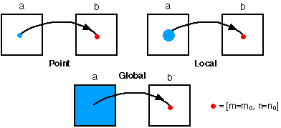
Image Operations

Slide 41
2.6 Linear and Nonlinear Operations
Let H be an operator whose input and output are images. H is said to be a linear
operator if, for any two images f and g and any two scalars a and b,
(2.6-1)
An operator that fails the test of Eq.(2.6-1) is by definition nonlinear.
Linear operations are exceptional important in image processing because they are based on a significant body of well-understood theoretical and practical results. Although nonlinear operations sometimes offer better performance, they are not always predictable, and for the most part are not well understood theoretically.

Slide 42
Summary
The material in this lecture is primarily background information for subsequent discussions.
Brief description on human visual system provides a basic idea of the capabilities of the eye in perceiving pictorial information.
The discussion of light and the electromagnetic spectrum is fundamental in understanding the origin of the many images we’ll use.
The image model developed in Section 2.3.4 is used in the following as the basis for an image enhancement technique called homomorphic filtering, and again to explain the effect of illumination on the shape of image histograms.
The sampling ideas introduced are the foundation for many of the digitizing
phenomena likely to be encountered in practice. These ideas can be expanded
further once a basic understanding of frequency content is mastered. The concepts of sampling and aliasing effects also are of importance in the context of image acquisition.
The concepts introduced in Section 2.5 are the basic building blocks for processing techniques based on pixel neighborhoods. Neighborhood processing methods are at the core of many image enhancement and restoration procedures.

Slide 43
Problems
2.7, 2.11, 2.14, 2.18, 2.19

Slide 44
Project(s)
Zooming and Shrinking Images by Bilinear Interpolation
(a) Write a computer program capable of zooming and shrinking an image by bilinear interpolation. The input to your program is the desired size of the resulting image in the horizontal and vertical direction. You may ignore aliasing effects.
(b) Download Fig. 2.19(a) and use your program to shrink this image from 1024 x 1024 to 256 x 256 pixels.
(c) Use your program to zoom the image in (b) back to 1024 x 1024. Explain the reasons for their differences.

